Slide 1
TRAFFIC SPEED RADAR
Dhananjay Sunil Menon
18BCE2330
YouTube Link :https://www.youtube.com/watch?v=_FKGOXCwlWQ

Slide 2

ABSTACT
Road Safety is an integral part of modern roads. This is why speed limits are given for a particular road depending on the quality of the road and the how prone the road is to accidents. Speed Cameras are set up at intervals of the road in order to catch speed-limit violators. Just like any other technology, speed cameras have progressed over the years. This project will focus on making a speed camera without sensors and only with Image processing of videos

Slide 3
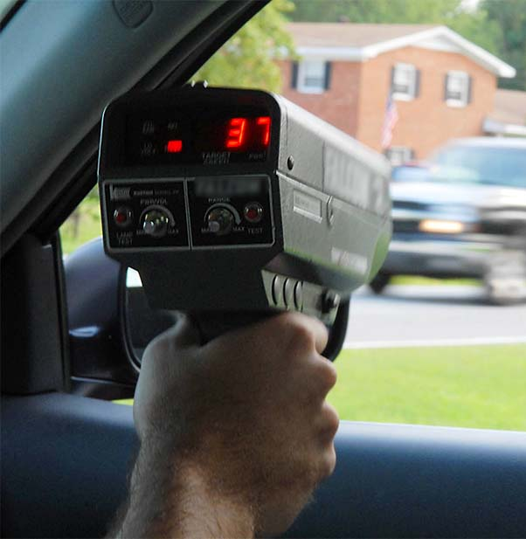
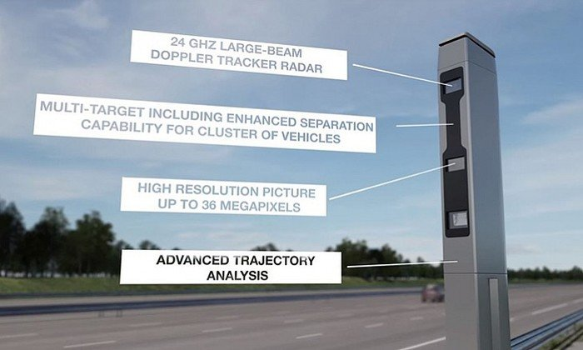
Introduction
Dopplar Speed Radar
Modern Speed Cameras

Slide 4
Literature Survey
Title | Authors | Year of Publication | Dataset Considered | Methodology Proposed | pros/cons | Future work possible
Determining vehicle speed based on video using convolutional Neural Network | Alexander Grents, Vitalii Varkentin, Nikolay Goryaev | 2020 | 750 images from over 52,000 objects. The images were obtained from traffic cameras of Intersvyaz company in the city of Chelyabinsk. Categories: cars, buses, trolleybuses, trucks, minibuses, ambulances, firetrucks, vans, uncategorized | Mask R-CNN architecture is used for vehicle detection. Masking was used on the road video so as to recognise vehicle accessible regions. A rectangular region is selected, and speed of a vehicle crossing the region is calculated with the help of equations. | Pros It is a straight-forward method. Cons The accuracy of this radar depends of the video camera resolution and frame rate. | Vehicle going on the wrong lane/hard-shoulder can be caught by these speed radars.

Slide 5
Literature Survey
Title | Authors | Year of Publication | Dataset Considered | Methodology Proposed | pros/cons | Future work possible
Detection of Vehicle Position and Speed using Camera Calibration and Image Projection Methods | Alexander A S Gunawan, Deasy Aprilia Tanjung, Fergyanto E. Gunawan | 2019 | Dataset not mentioned | Direct Linear Transformation is used for estimating the length of a segment of road. Vehicle position is detected using Background Subtraction and speed is determined by Mixture of Gaussian (MoG) Camera Calibration is used to calculate target position of vehicle in 3D space. Python libraries OpenCV and Kivy were used. | Pros High Accuracy (96% claimed) Length of segment of road is calculated through image. No need for manual measurements. Cons Best result is when camera is on top of the road. Does not support multi-vehicle traffic | Multi veicle detection can be used. Tailgating can be monitored.

Slide 6
Literature Survey
Title | Authors | Year of Publication | Dataset Considered | Methodology Proposed | pros/cons | Future work possible
Vehicle speed measurement model for video-based systems | Saleh Javadi, Mattias Dahl, Mats I. Pettersson | 2019 | Dataset not mentioned | Foreground, BG separation. Gaussian Mixture Model. License Plate Tracking is used. The detection distance is directly proportional to the vehicle’s speed and inversely proportional to the camera’s frame rate. | Pros It is a simple idea to implement. Cons Does not classify vehicles Best result is only when camera is on top of the road | Tailgating can be monitored. Driving on the wrong lane can be detected

Slide 7
Literature Survey
Title | Authors | Year of Publication | Dataset Considered | Methodology Proposed | pros/cons | Future work possible
An Efficient Approach for Detection and SpeedEstimation of Moving Vehicles | Tarun Kumar and Dharmendar | 2016 | Dataset not mentioned | First Image acquisition and preprocessing is done. then background is modelled. Camera calibration is used to map the relationship with real world. Dark shaded area under vehicle is the region of interest. S = d*f/n | Pros It claims a high accuracy (87 -98%). Cons Accuracy varies on time of day. Mostly it would be ineffective at night | Classification of vehicles Recording of number-plates

Slide 8
Literature Survey
Title | Authors | Year of Publication | Dataset Considered | Methodology Proposed | pros/cons | Future work possible
Fast and accurate on-road vehicle detection based on color intensity segragation | Manne Sai Sravan, Sudha Natarajan, Eswar Sai Krishna, Binsu J Kailath | 2018 | Dataset not mentioned | This uses lane tracking and ROI extraction. A custom vehicle filter consisting of erosion and dilation is made. | Pros It does not need a dataset of vehicles to detect Cons No classification of vehicles. It cannot be used for multiple vehicles | Driving on the wrong lane can be detected

Slide 9
BASE PAPER
Vehicle speed measurement model for video-based systems
This paper uses segmentation of the road into strips for estimation of the speed of the vehicle. If we know the length of a segment of road and the time taken to cover it, we can determine the speed. Frame-rate can be used to assess the accuracy of speed calculation.
A minimum speed of object is set up so as to not record unnecessary objects like bicycles and bird shadows.
Determining vehicle speed based on video image subtraction
This paper uses deep learning to identify vehicles based on image subtraction and contour detection.

Slide 10
PROBLEM STATEMENT
The objective of this project is to create a traffic radar using Image Processing in Python by using OpenCV and Tensorflow.
When is comes to tracking the speed of vehicles on a segment of road, the vital steps of this projects is:
Vehicle Detection
Speed estimation
Capturing vehicle image

Slide 11
PROBLEM STATEMENT
Video Aquisition
A video with good clarity and good fps (30-60) would be taken to record vehicles passing by on a road.
Object Recognition
Deep learning would be used to identify vehicles with Tensorflow using faster RCNN or Yolo. Multiple vehicles are to be detected at a time on a road segment.
Classification of vehicles into cars and trucks are also to be done

Slide 12
PROBLEM STATEMENT
Speed Estimation
This would be done by using time taken to cover a segment of road taking into consideration the accuracy (which is mostly determined by frame-rate).
The road shall be divided to multiple segments to estimate speed.
Save Vehicle Image
This can be done after saving still images of the violators. Each vehicle is given a specific ID. The ID and speed details are saved to a text file
A good quality video is required to capture the number-plate of vehicles

Slide 13
PROJECT MODEL
Video Acquisition
Image Recognition and region of interest monitored
Speed Calculation
Save Vehicle Image
Define Region of Interest
Image Subtraction
Start Timer and Save in array
Crop Image based in Contour Detections
Masking and Erosion
Stop Timer and Save in Array
Save Vehicle Image in File
Contour Detection
Calculate Speed and save in array
Save ID and speed in Text File
Object Tracking
Display on Bounding Box
Add Summary at end of text file
Draw Bounding Box

Slide 14
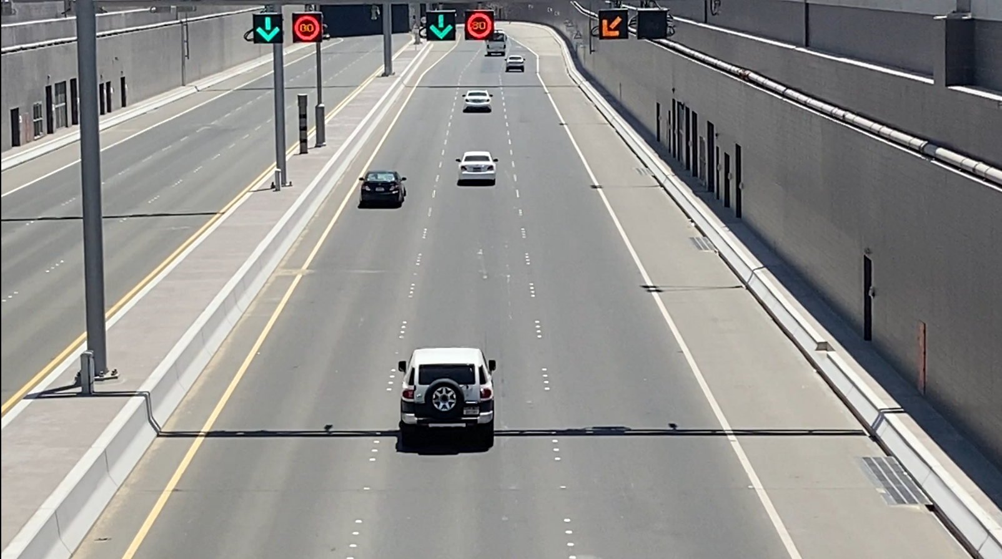
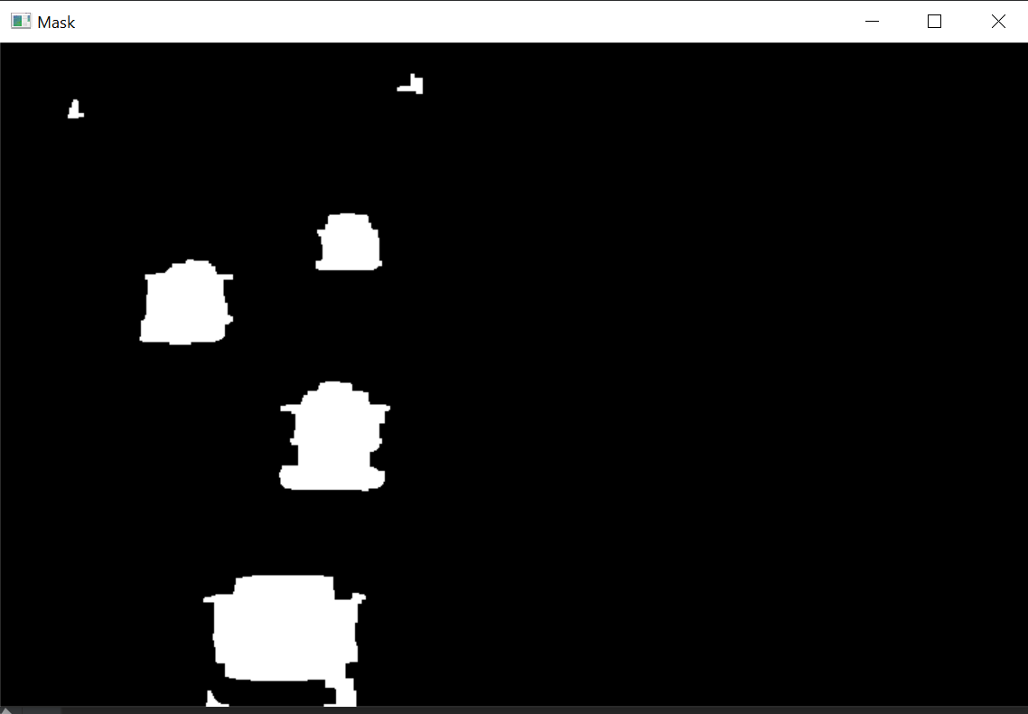
PROJECT MODEL – Object Tracking
DETECT CONTOURS
OBJECT TRACKER
ELIMINATE
BASED ON AREA

Slide 15


SPEED ESTIMATION
CAPTURE IMAGE and
SAVE SPEED
END TIMER s2[ID]
START
TIMER
s1[ID]

Slide 16
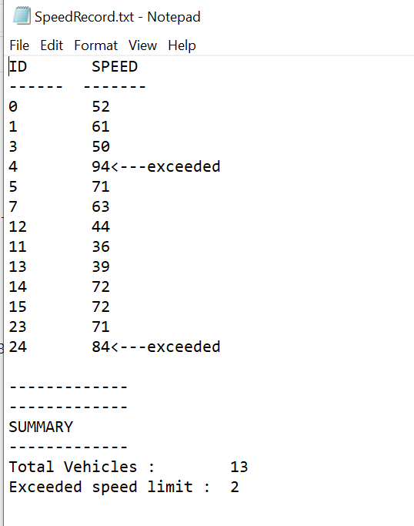
SAVE VEHICLE DATA
TRAFFIC RECORDS
ID_SPEED_60.txt

Slide 17
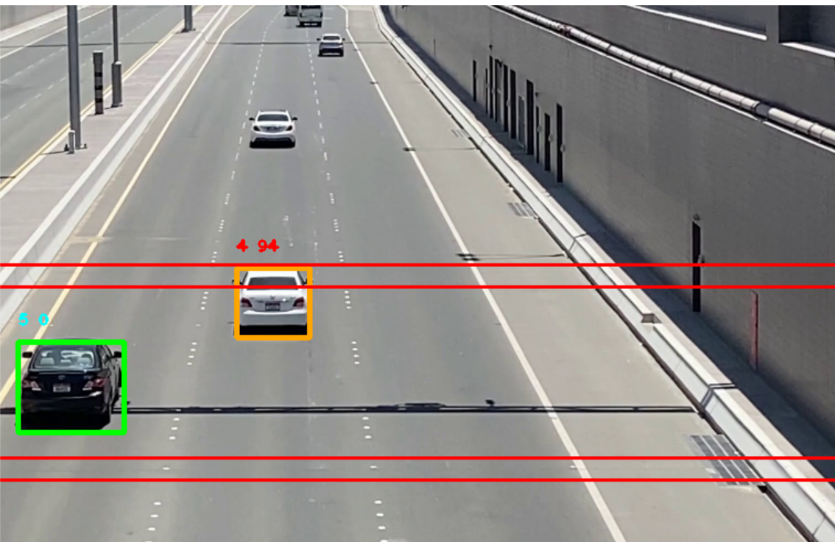
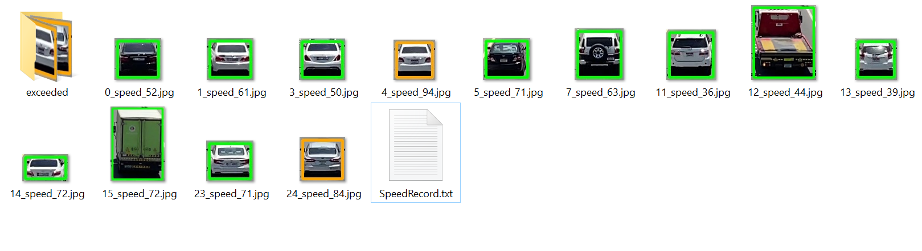
SCREEN SHOTS

Slide 18
Project challenges and updates
Objects that weren’t vehicles were being detected
- This was sorted by changing the masking method.
Number Plates Unreadable
Pictures of vehicles were stored instead.

Slide 19
Project challenges and updates
Multiple vehicles speeds were unable to be detected
This was sorted by saving speed timers in an array format instead of an single integer format
Vehicles close together were clubbed as single object
Eroded Masked Image to better differentiate close objects
Moved detection lines further back

Slide 20
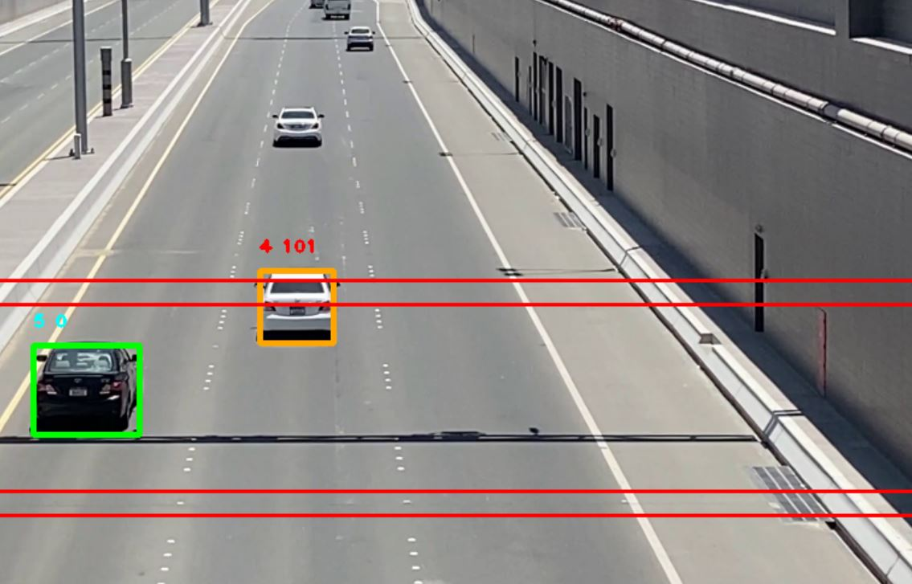
Video Link - YouTube
https://www.youtube.com/watch?v=_FKGOXCwlWQ

Slide 21
References
Determining vehicle speed based on video using convolutional neural network
https://www.sciencedirect.com/science/article/pii/S2352146520307705
Detection of Vehicle Position and Speed using Camera Calibration and Image Projection Methods
https://www.sciencedirect.com/science/article/pii/S187705091931083X
Vehicle speed measurement model for video-based systems
https://www.sciencedirect.com/science/article/pii/S0045790618317774
An Efficient Approach for Detection and SpeedEstimation of Moving Vehicles
https://www.sciencedirect.com/science/article/pii/S1877050916311103

